Slide 1
Income and Substitution Effects
Rajiv Sethi and the CORE Team
September 29, 2020

Slide 2
Overview
Hours of work and economic growth
Budget constraints
Income and substitution effects
The model in real life
Changes in working hours over time
Differences in working hours among countries
Reading: The Economy Units 3.6-3.11

Slide 3
Rising Income
When incomes rise, consumption patterns change
This is true for individuals, families, and countries
At low income, food and shelter take up most of expenditure
As incomes rise, both quantity and variety of consumption increases
But richer countries also have higher wages on average
Do people work more hours since opportunity cost of free time is higher?
Or do people work fewer hours since free time itself is more valuable?
Answer depends on strength of income and substitution effects

Slide 4
Prosperity and Hours Worked

Slide 5
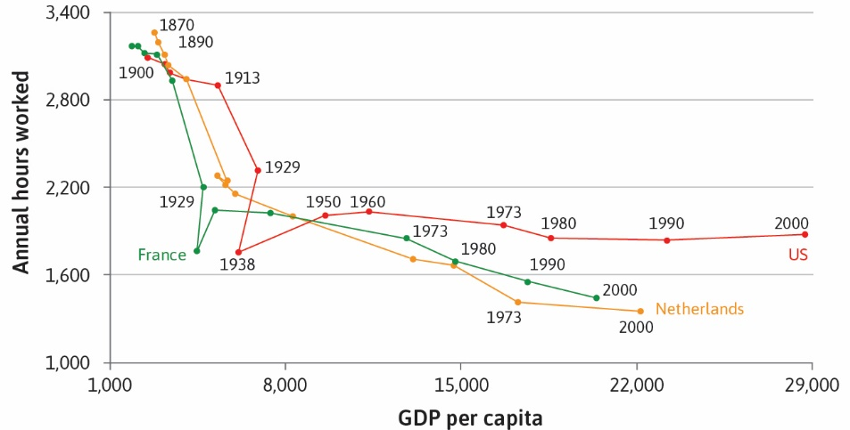

Slide 6
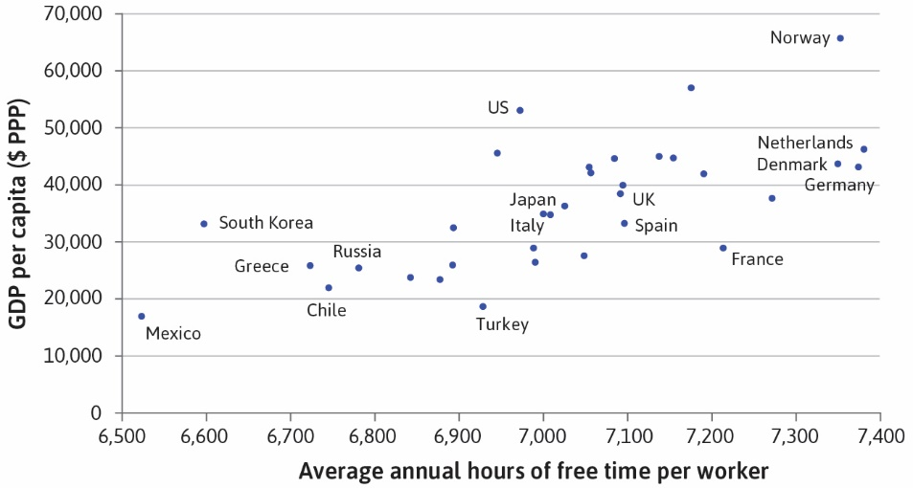

Slide 7
Productivity Increases
Incomes rise, in part, through greater productivity
Improvements in technology, greater automation
This means an upward shift in the production function
Equivalently, an upward shift in the feasible frontier
Allowing a more preferred allocation to be attained
Equivalently, allowing a higher indifference curve to be reached

Slide 8
Example
Input is labor, output is grain
Initially 12 hours of labor produces 64 units of grain
After rise in productivity, 12 hours produces 74 units
And to get 64 units takes just 8 hours
Do you maintain hours and produce more?
Or maintain production and reduce hours?
Or some combination of the two? Or something else entirely?

Slide 9
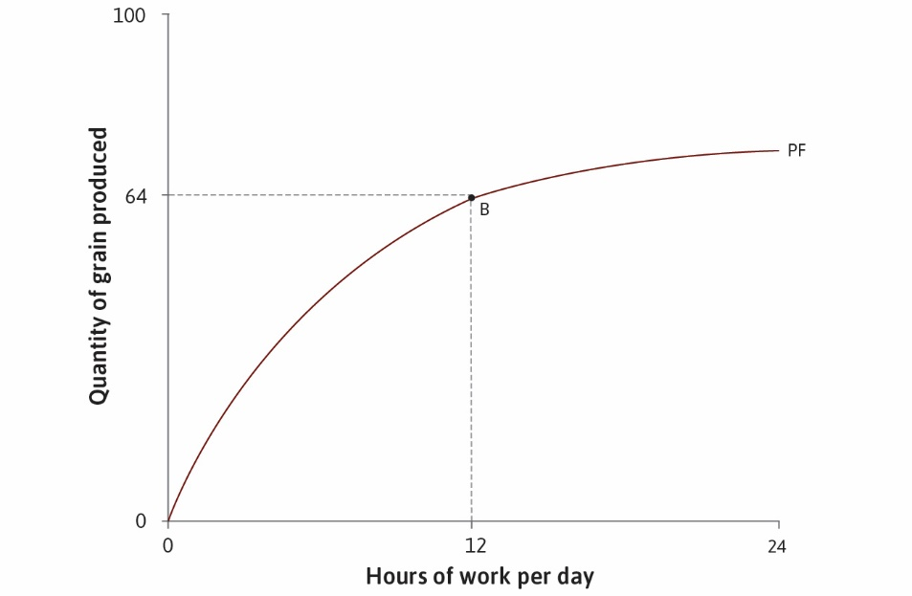

Slide 10
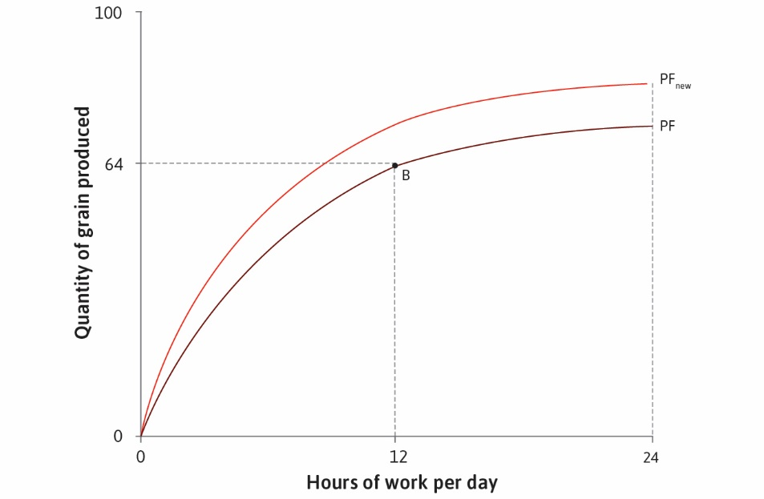

Slide 11


Slide 12


Slide 13
Example (continued)
Consider feasible frontier instead of production function
Initially 12 hours of free time consistent with 64 units of grain
After rise in productivity, 12 hours free time consistent with 74 units
And 64 units can be obtained while having 16 hours free
Do you maintain free time and produce more?
Or maintain production and increase free time?
Or some combination of the two? Or something else entirely?

Slide 14
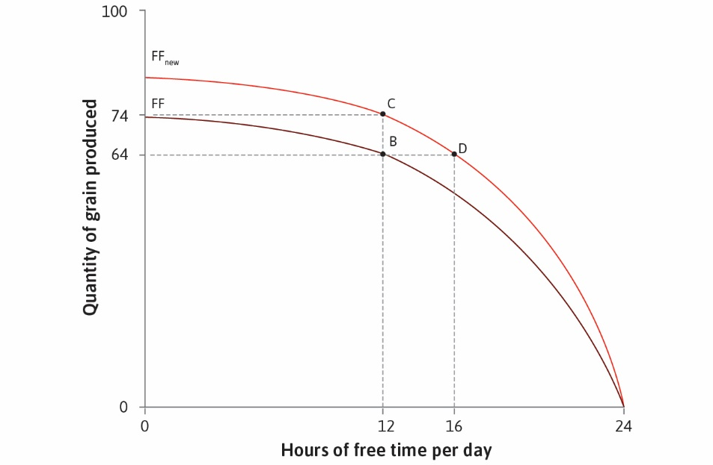

Slide 15
Example (continued)
Suppose initially at point A where MRS = MRT (next slide)
Shift to point E, maintaining MRS = MRT
Result (in this case) is more grain and more free time
And higher well-being (higher indifference curve)
This combines income and substitution effects
Work is more rewarding so more incentive to work (substitution)
But income is higher so can afford more free time (income)
Can we separate these effects conceptually?

Slide 16
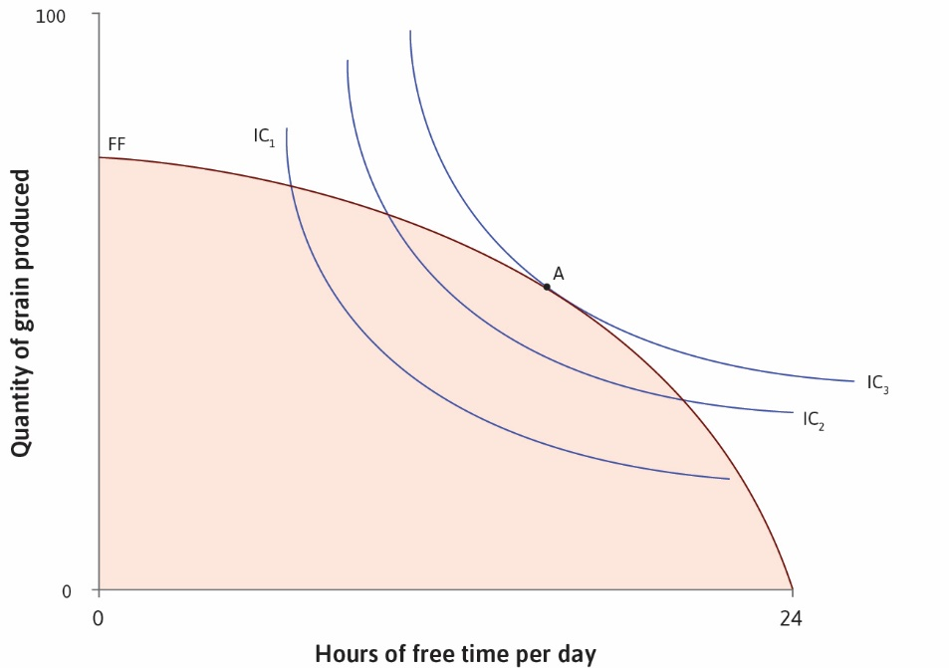

Slide 17
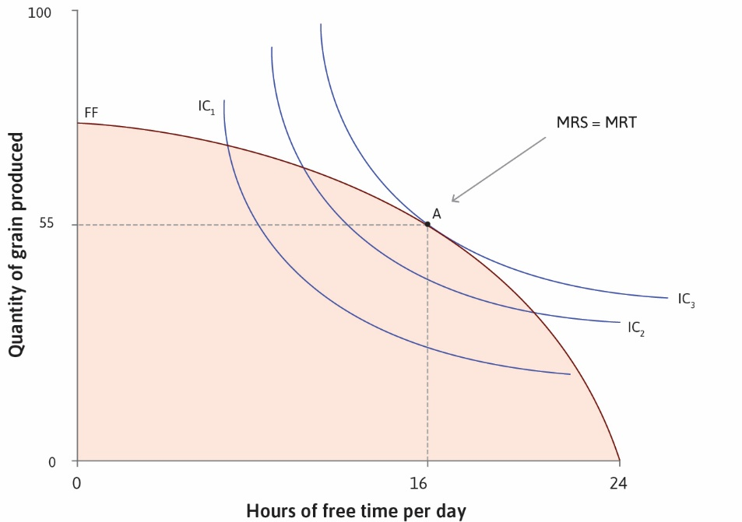

Slide 18
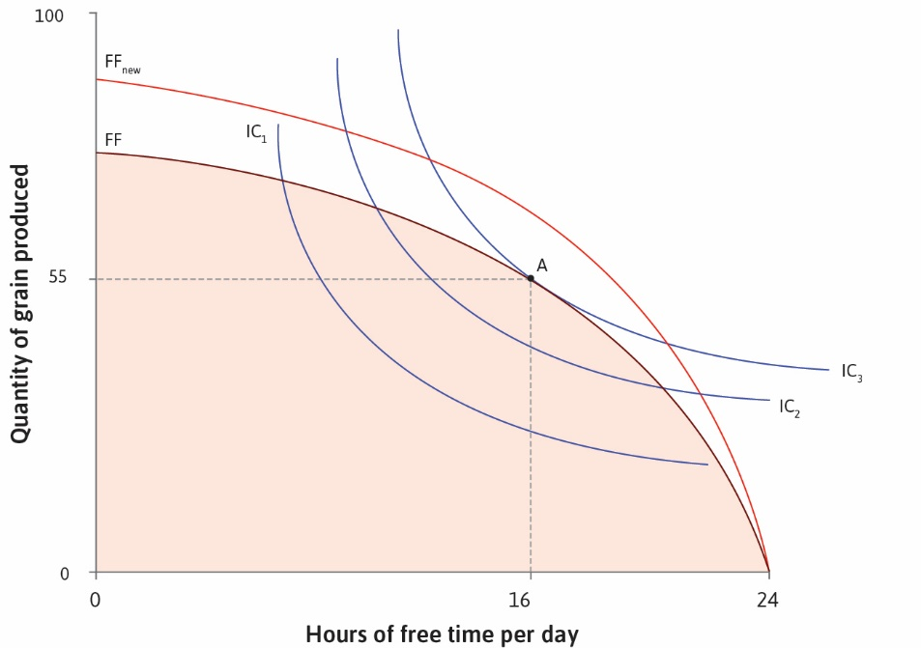

Slide 19
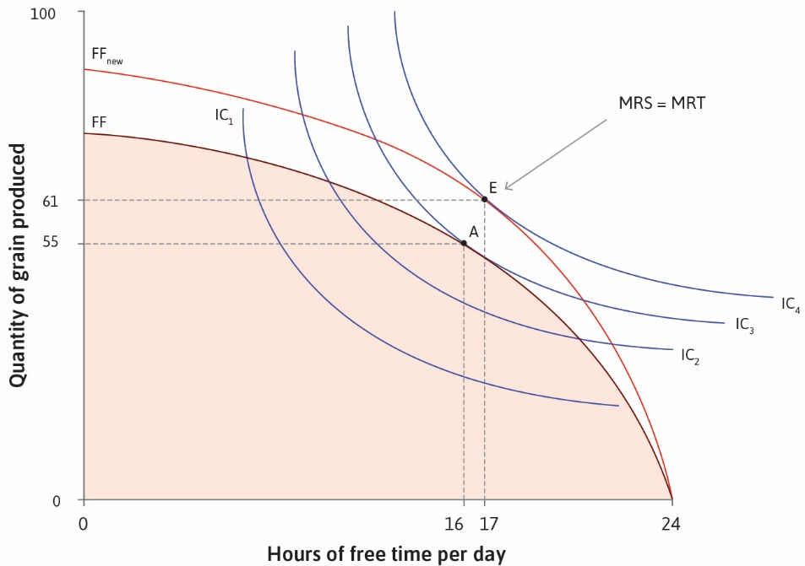

Slide 20
A Pure Income Effect
Suppose hourly wage is $15, so 16 hours work (8 hours free) yields $240
And 8 hours work (16 hours free) yields $120
And no hours work (24 hours free) yields nothing
The feasible frontier is then a straight line (next slide)
Given preferences, choose point at highest indifference curve, MRS = MRT
Solution (given these preferences) is about 18 hours free (6 hours work)
Which yields $90 for consumption (see point A on slide)

Slide 21
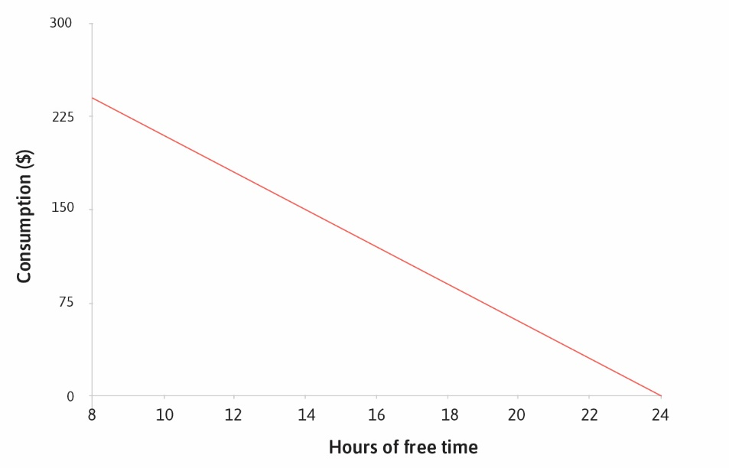

Slide 22
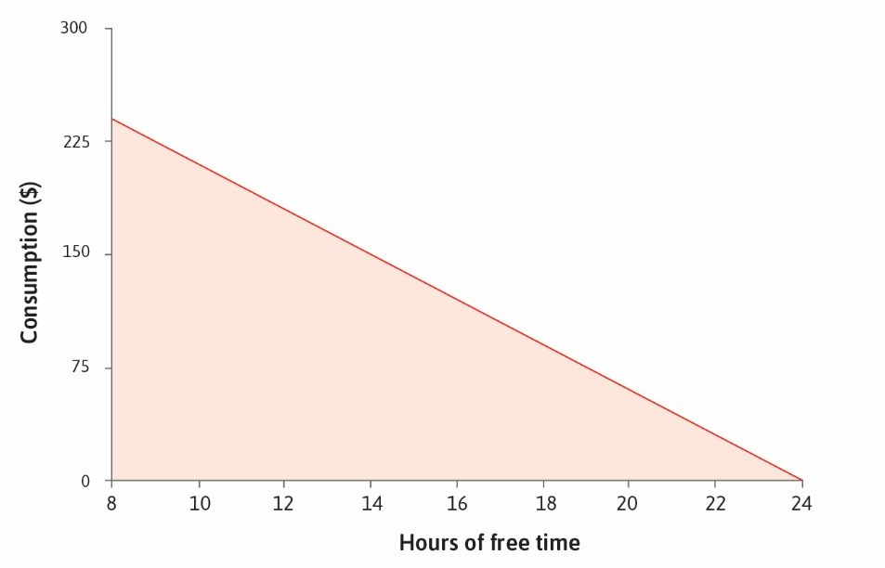

Slide 23
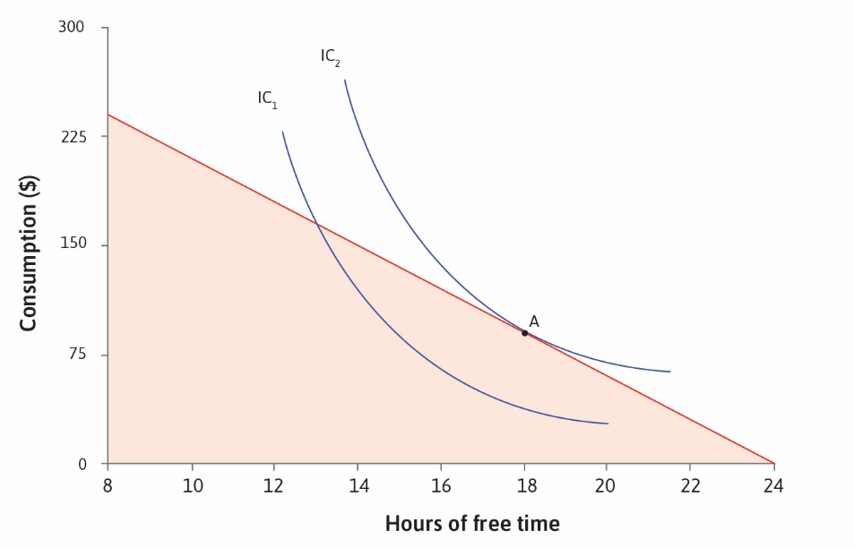

Slide 24
A Pure Income Effect (continued)
Now suppose your receive $50 payment independent of work
For example: universal basic income
What happens to the feasible frontier?
How does the optimal choice change?
Can afford more consumption and/or more free time
Is it possible that you choose less free time and lots more consumption?
Depends on preferences

Slide 25
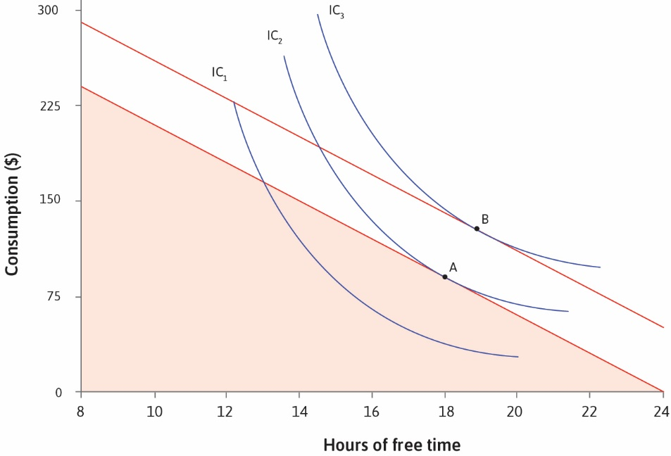

Slide 26
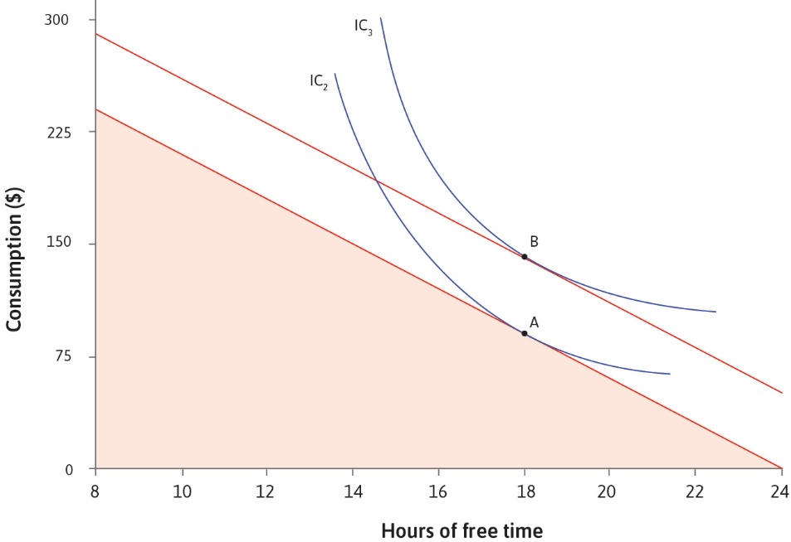

Slide 27
Changes in Wages
Now suppose no extra cash income, but wages rise to $25 per hour
Effectively you have more income (can get more for same work)
But now there is also a substitution effect
Free time has become more costly (need to give up more in wages)
Suppose you switch to point D (next slides)
This combines both income and substitution effects
Can we separate the two?

Slide 28
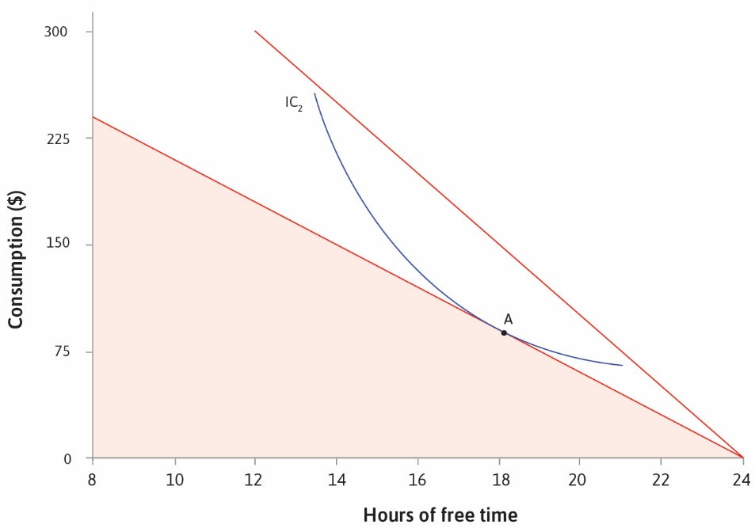

Slide 29
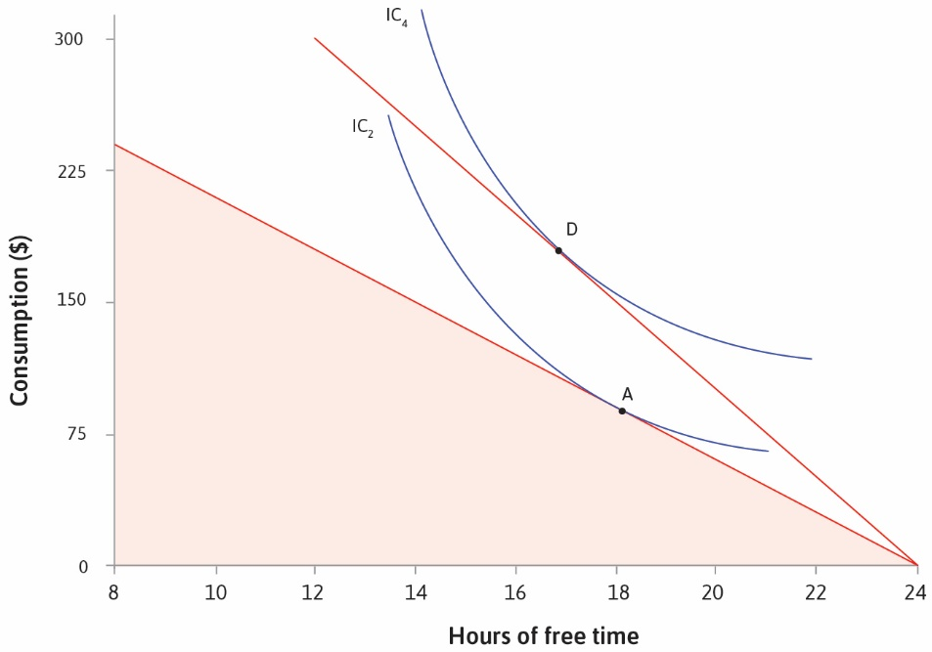

Slide 30
Income and Substitution Effects
Point D lies on a higher indifference curve
Suppose you could get there with cash payment rather than wage change
How much extra income would it take?
Consider point C, which would be optimal under sufficient cash payment
If you got just enough cash to get to higher curve without wage change
Compare free time at C with free time at A (income effect)
Compare free time at D with free time at C (substitution effect)
Compare free time at D with free time at A (overall effect)

Slide 31
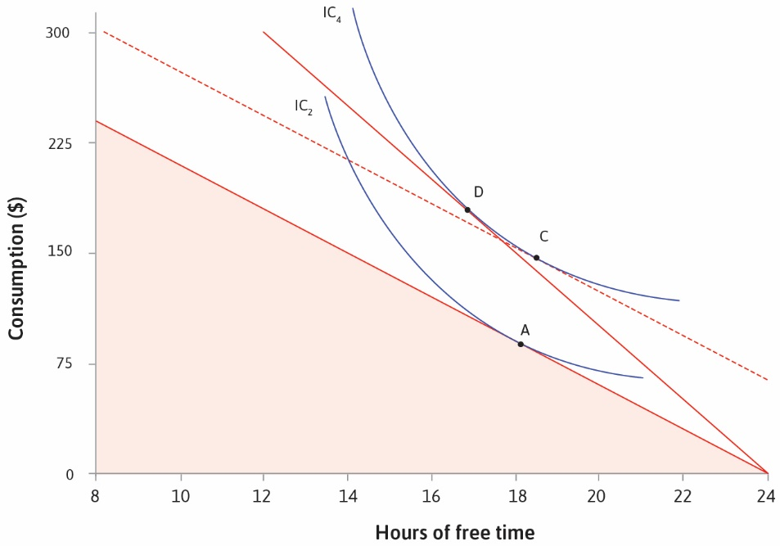

Slide 32
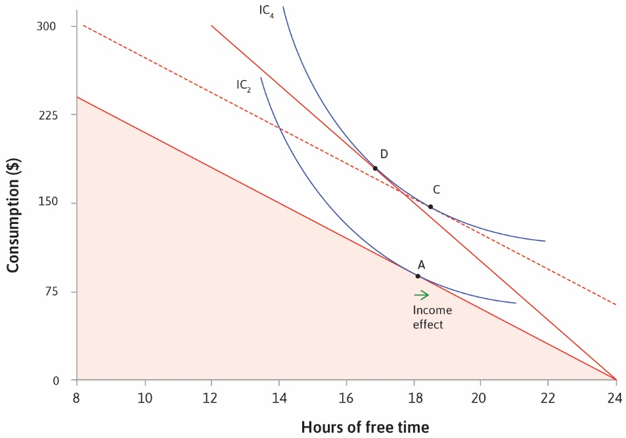

Slide 33
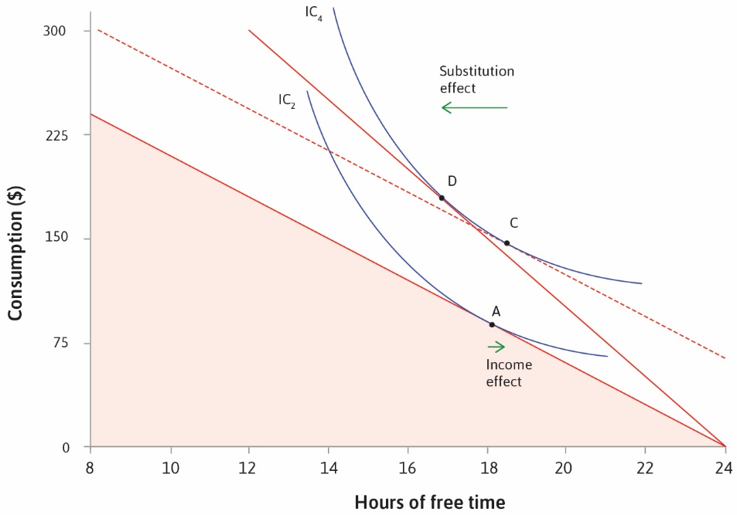

Slide 34
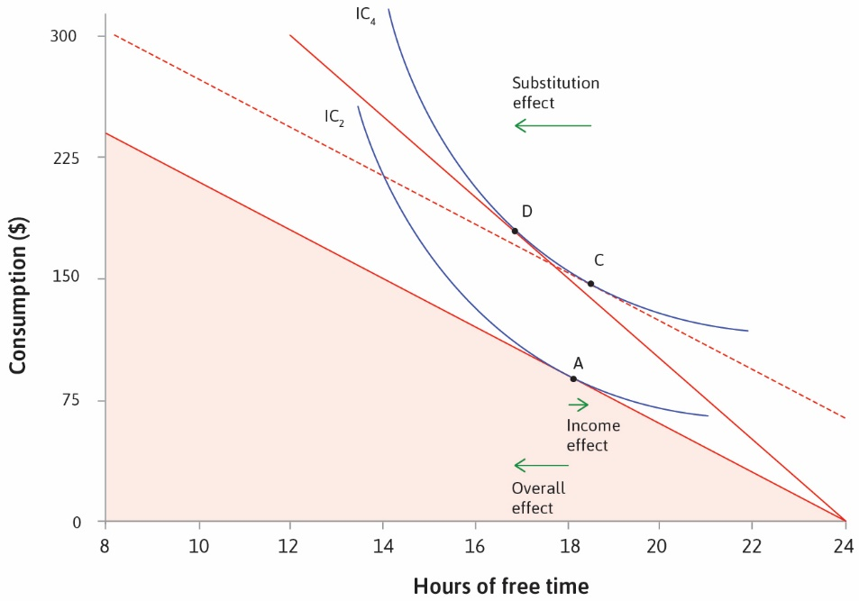

Slide 35
Historical Data
History suggests over the long run, income effect dominates
Free time rises overall, though substitution effect limits extent of rise
And preferences differ across countries (indifference curves cross)
But unmistakable decline in lifetime working hours
Lower hours per week, earlier retirement, elimination of child labor
Much of these due to changes in laws and the balance of power
Some due to preferences and income effects

Slide 36
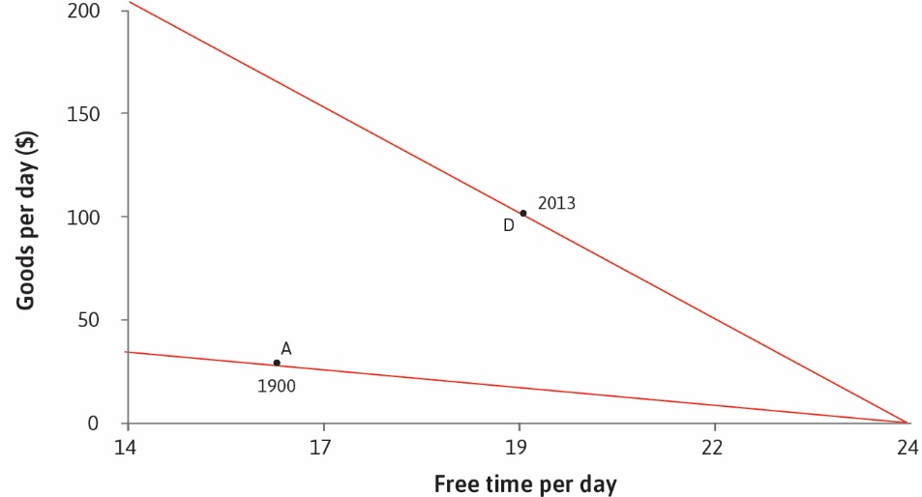

Slide 37
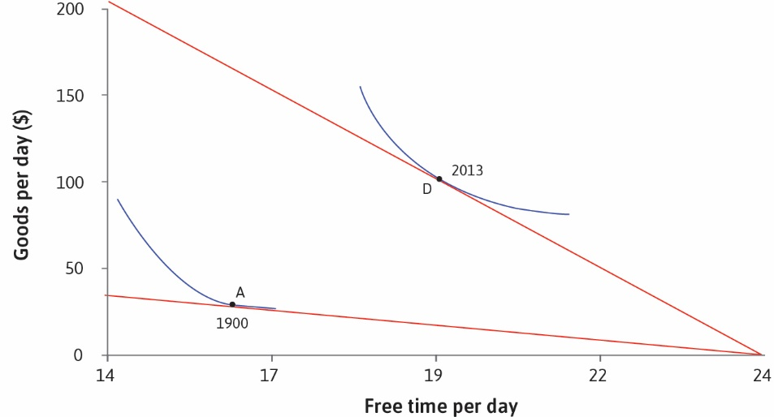

Slide 38
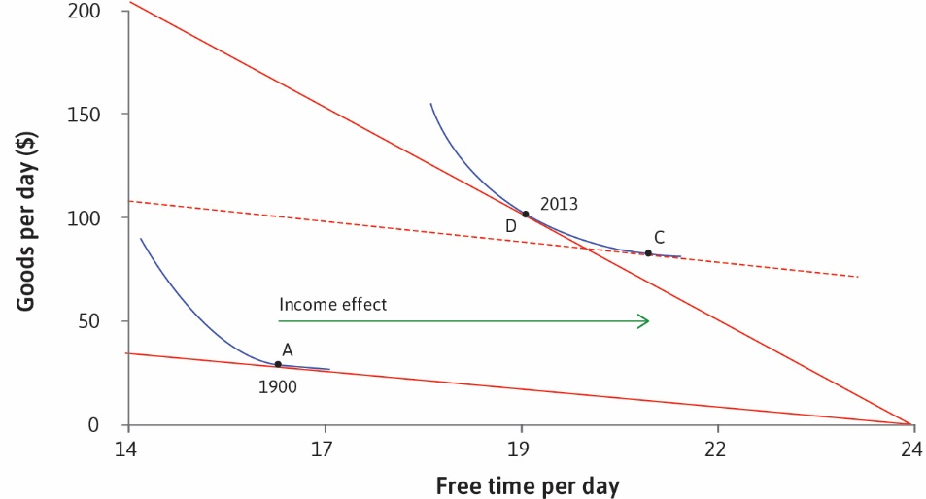

Slide 39
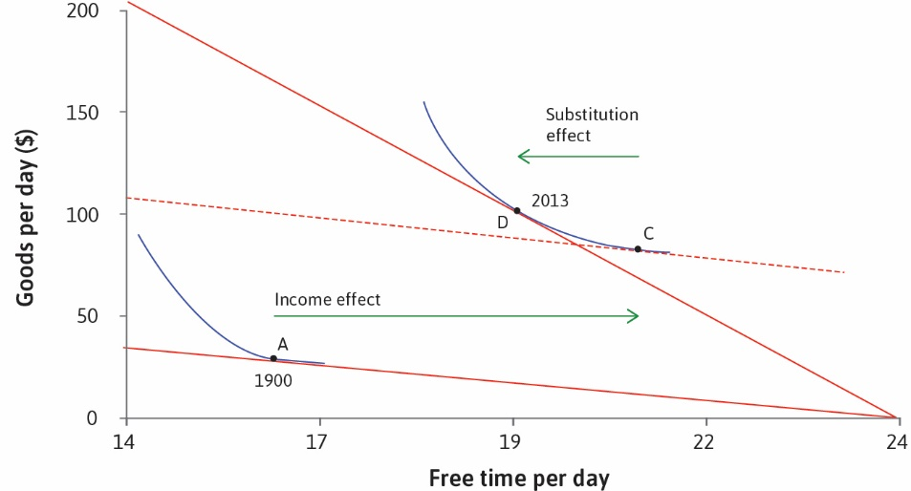

Slide 40
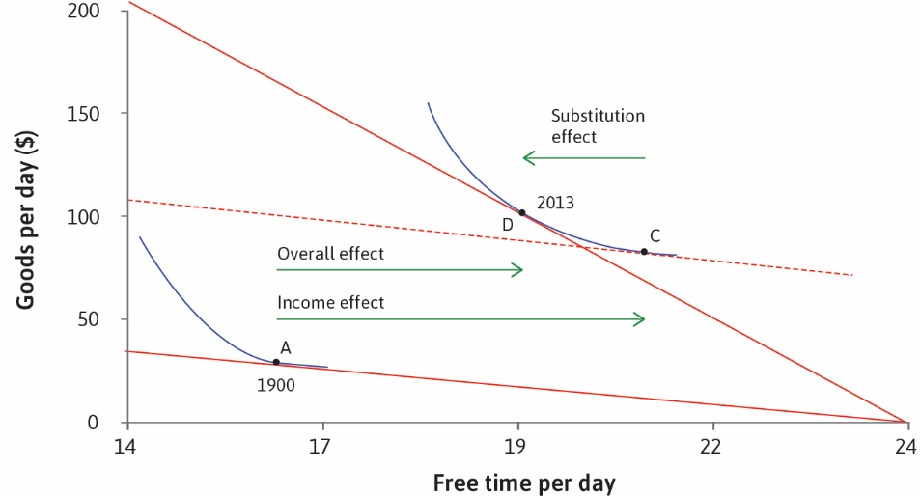

Slide 41
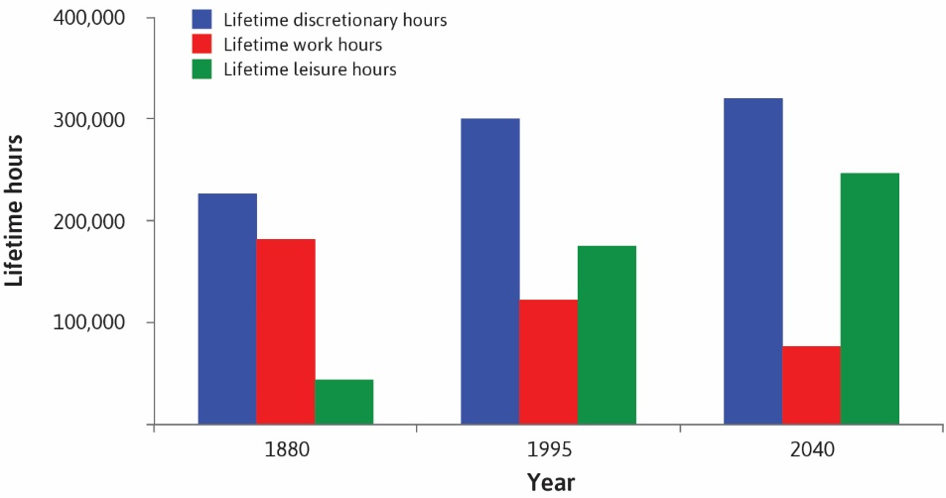

Slide 42
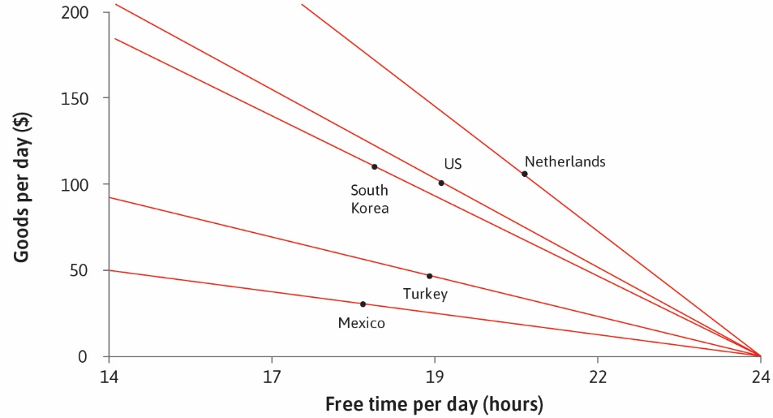

Slide 43
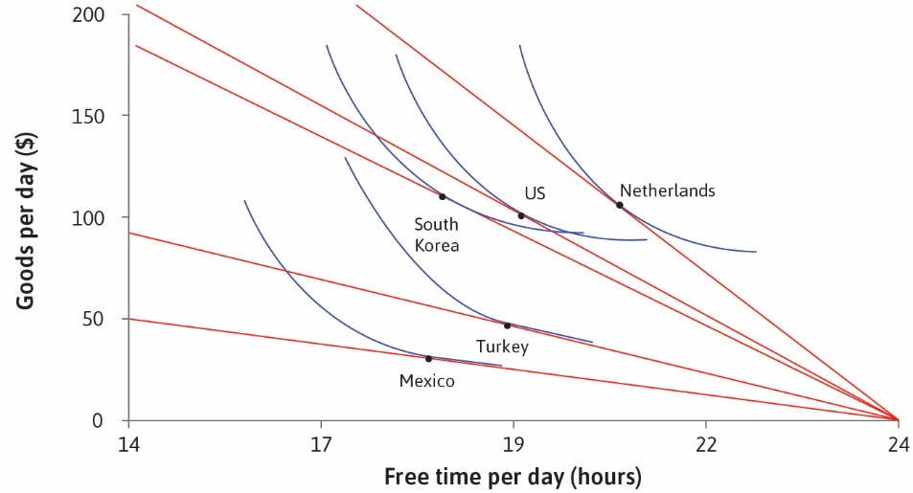

Slide 44


Slide 45
